Slide 1
Credit Card Fraud Detection
Anomaly detection of fraudulent transactions
Anthea Silvia Sasdelli
Course of Artificial Intelligence in Industry

Slide 2
Project development
1. Dataset analysis
2. GMM
3. Autoencoder

Slide 3
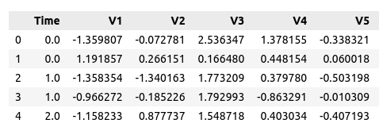
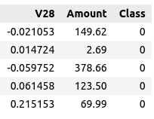

Dataset analysis
Credit Card Fraud Detection dataset from kaggle
The dataset was taken from Kaggle and is composed by :
284807 transaction made by credit cards in September 2013 by European cardholders.
Each transaction contains:
The time: number of seconds elapsed between each transaction
Features V1 to V28: Principal components derived from PCA
Amount: The monetary value of each transaction.
Class: The response variable indicating whether the transaction is fraudulent (1) or legitimate (0).
Notes:
Principal Component Analysis (PCA) is a statistical technique used to reduce the dimensionality of data by identifying the directions (principal components) along which the variance of the data is maximized, allowing for a simplified representation while preserving as much information as possible.

Slide 4
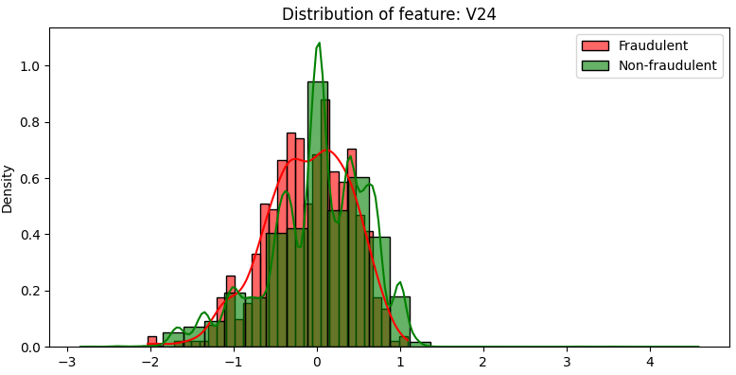
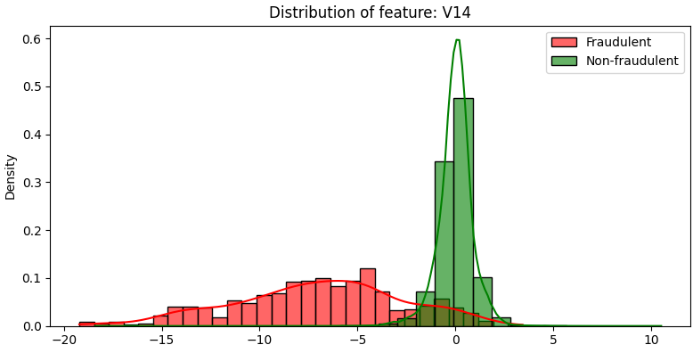
Dataset analysis
Dataset simplification and data processing
The distributions of the features are then plotted to see how they were distributed. Since some of them had huge overlaps and unclear distinction between the two classes, the dataset has been simplified.
Discarded
Kept

Slide 5
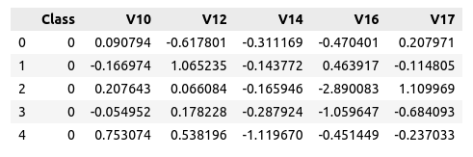
Dataset analysis
Dataset simplification and data processing
The distributions of the features are then plotted to see how they were distributed. Since some of them had huge overlaps and unclear distinction between the two classes, the dataset has been simplified.
It was used Random Forest to find the best features.

Slide 6
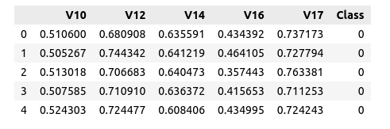
Dataset analysis
Dataset simplification and data processing
The dataset is then normalized, an operation recommended for GMM but essential for Autoencoder.
The dataset is then divided in :
normal: every normal transaction (Class == 0)
fraud: every fraudulent transaction (Class == 1)

Slide 7

Dataset analysis
Dataset simplification and data processing
Upon further analysis of the dataset, a strong imbalance between the elements of the two classes was noted.
Because of this it was decided to divide the normal dataset in two:
the test dataset, that contains a ratio of 3:1 (three normal transaction each fraudulent one)
the train dataset, that contains the rest of the normal transactions
In this way it was possible to create a balanced normal test dataset.

Slide 8
Dataset analysis
Dataset split
Train
Test
This means that the models will be trained with the new split of normal dataset, which doesn’t contain any fraudulent transaction ( UNSUPERVISED LEARNING )

Slide 9
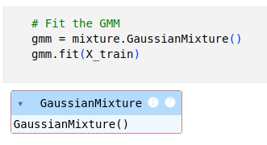
GMM
What are the Gaussian Mixture Models
A Gaussian mixture model is a probabilistic model that assumes all the data points are generated from a mixture of a finite number of Gaussian distributions with unknown parameters. One can think of mixture models as generalizing k-means clustering to incorporate information about the covariance structure of the data as well as the centers of the latent Gaussians.
For this project it has been used the class of scikit-learn : sklearn.mixture.GaussianMixture
Notes:
The Gaussian Mixture Model (GMM) is a probabilistic model that assumes data points are generated from a mixture of several Gaussian distributions

Slide 10
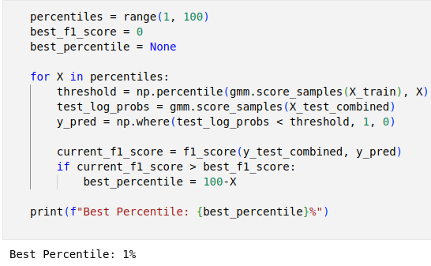
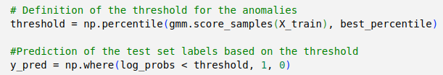
GMM
Pipeline
Then the log-probabilities are calculated on the train split.
They indicate how well each point fits the distribution learned from the model.
The threshold was calculated by checking which percentile maximized the F1 score on the test set. Specifically, for each percentile, it was computed a threshold based on the GMM score distribution for the training data.

Slide 11
GMM
Results
 | Precision | Recall | F1-score | Support
Normal | 0.95 | 0.99 | 0.97 | 1476
Anomaly | 0.97 | 0.85 | 0.90 | 492
Accuracy | - | - | 0.95 | 1968
Macro avg | 0.96 | 0.92 | 0.94 | 1968
Weighted avg | 0.96 | 0.95 | 0.95 | 1968
Accuracy : 0.9547764

Slide 12
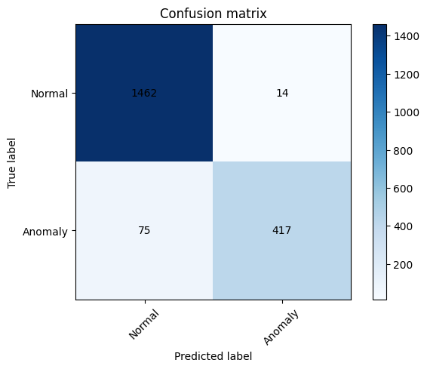
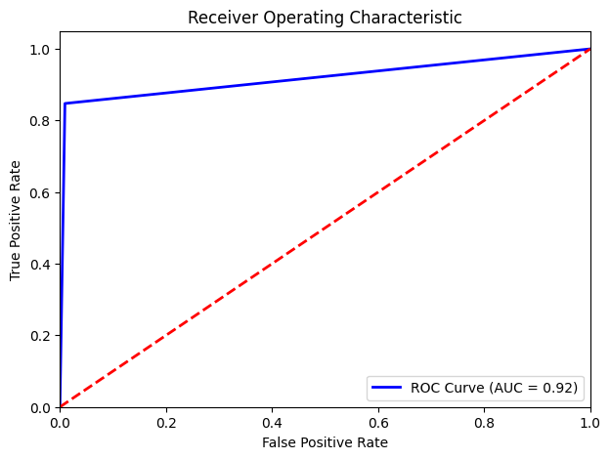
GMM
Results
Notes:
The ROC (Receiver Operating Characteristic) curve is a graphical representation used to evaluate the performance of a binary classifier. It plots the True Positive Rate (sensitivity) against the False Positive Rate, showing the trade-off between correctly identifying positives and incorrectly classifying negatives.
A model with *high performance* will have a ROC curve that approaches the top-left corner, indicating a high True Positive Rate and a low False Positive Rate. The area under the ROC curve, known as AUC, quantifies overall performance: the closer the AUC is to 1, the better the model is at distinguishing between the classes.

Slide 13
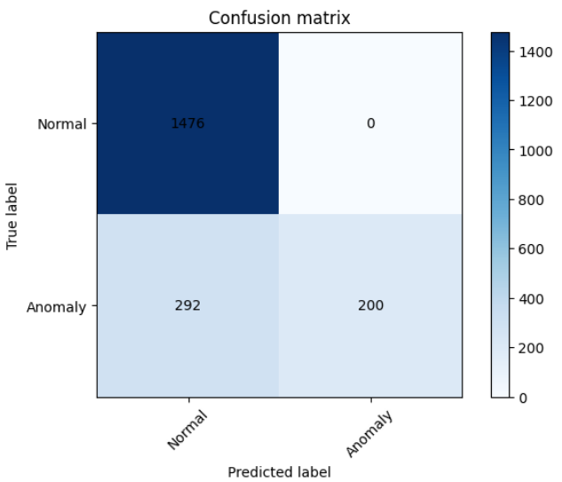
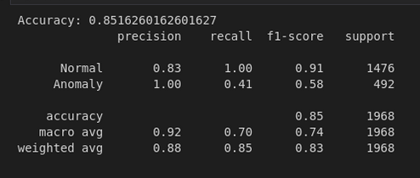
Autoencoder
More data preprocessing
Another modification had to be made to the train set as it was too high in relation to the number of fraudulent examples in the test set.
In fact, as can be seen in the diagram below, the model was unable to identify the anomalies.

Slide 14
Autoencoder
More data preprocessing
It was decided to put a ratio of 10:1 in the train set.
Train
Validation
Test
The train dataset has shape: (10332, 5)
The val dataset has shape: (4428, 5)
Previous shape of the train:

Slide 15
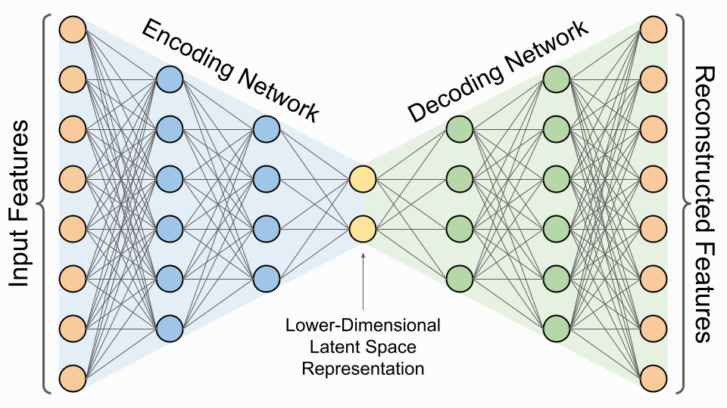
Autoencoder
What is an autoencoder?
Notes:
An autoencoder is a type of neural network designed to learn representations of data by encoding input into a lower-dimensional space and then reconstructing it,

Slide 16
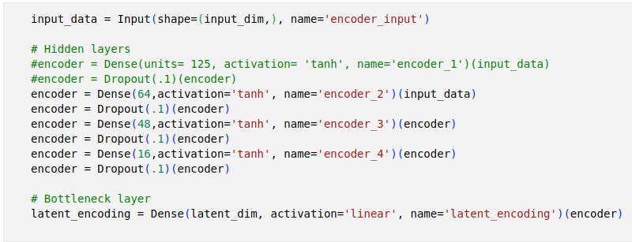
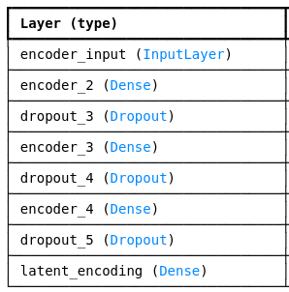
Autoencoder
Encoder

Slide 17
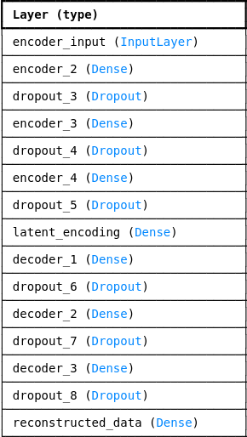
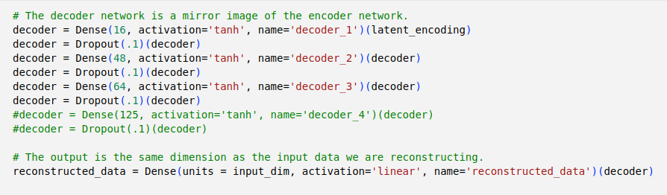
Autoencoder
Decoder

Slide 18
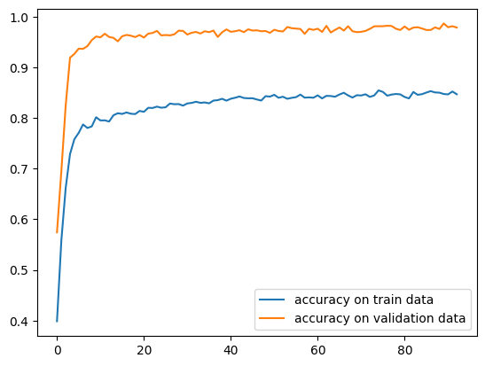
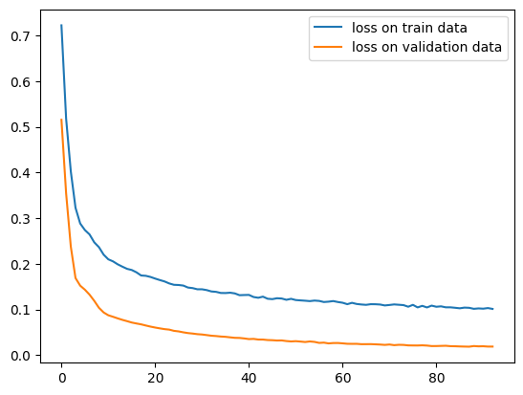
Autoencoder
Some graph of the training

Slide 19
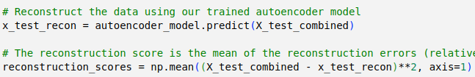
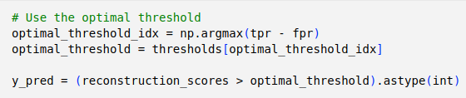
Autoencoder
Pipeline
Next, the model reconstructs X_test_combined, and reconstruction scores (mean squared errors) are calculated. These scores indicate how well each sample is represented by the model, with higher scores suggesting potential anomalies.
The threshold was chosen to maximize the F1 score on the test set. Specifically, it was set based on the point where the difference between the True Positive Rate (tpr) and False Positive Rate (fpr) was greatest.

Slide 20
Autoencoder
Results
 | Precision | Recall | F1-score | Support
Normal | 0.94 | 1.00 | 0.97 | 1476
Anomaly | 0.98 | 0.82 | 0.89 | 492
Accuracy | - | - | 0.95 | 1968
Macro avg | 0.96 | 0.91 | 0.93 | 1968
Weighted avg | 0.95 | 0.95 | 0.95 | 1968
Accuracy : 0.950203252

Slide 21
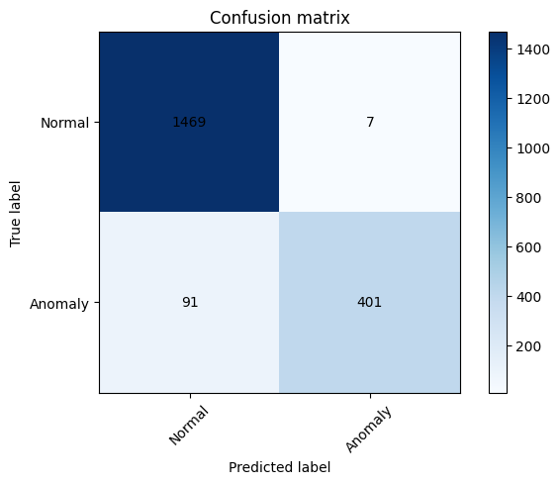
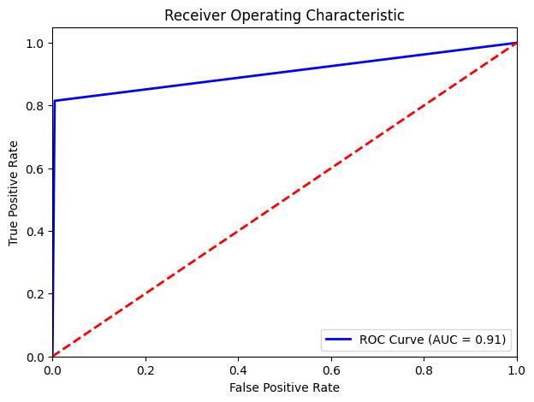
Autoencoder
Results

Slide 22
Conclusions
The GMM demonstrated a strong capability for anomaly detection, achieving an average accuracy of 95.5% on the test data. This model effectively captured the data distribution, allowing it to detect anomalies reliably. Notably, GMM also showed a superior trade-off between false positives and false negatives compared to the Autoencoder, which is essential for minimizing costly false alarms in fraud detection.
On the other hand, the Autoencoder achieved a slightly lower accuracy of 95%. While its architecture offers flexibility, the model’s complexity did not translate to higher accuracy. Additionally, the Autoencoder’s false positive-to-false negative ratio was less balanced than GMM's, impacting its overall reliability in this context.
Overall, the results suggest that the GMM s a slightly more effective choice for fraud detection in this context, providing a better balance between accuracy and the cost of misclassifications. This makes it a robust option when prioritizing both detection precision and manageable false alarm rates.

Slide 23
Further improvements
Dataset managing : as has been pointed out previously the dataset has been simplified, both in the choice of components to be used and in the rationalization (caused by the imbalance of the two classes). So a possible development might be:
to increase the number of components of the simplified dataset, if not use it in its entirety;
to use synthetic data (data augmentation) to create more fraudulent data .
Different Autoencoder Structure or hyperparameters : the autoencoder can be setted with different hyperparameters or built with a different structure (more layer, different activation, more/less neurons, ...)
Choose different models for the Anomaly Detection
Notes:
semisupervised

Slide 24
Thanks for your
attention

Slide 25
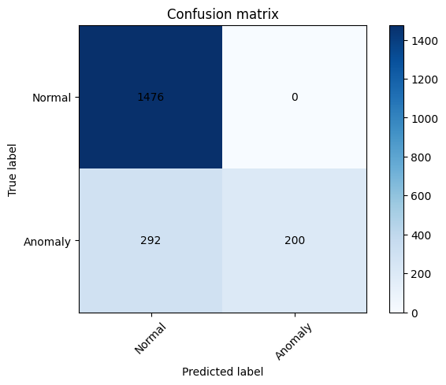
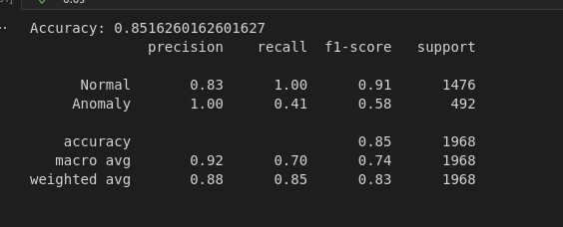
If all the dataset is used for the train

Slide 26

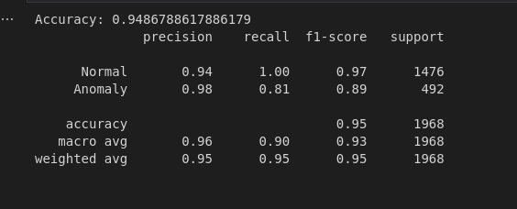
If we use the ratio 10:1

Slide 27
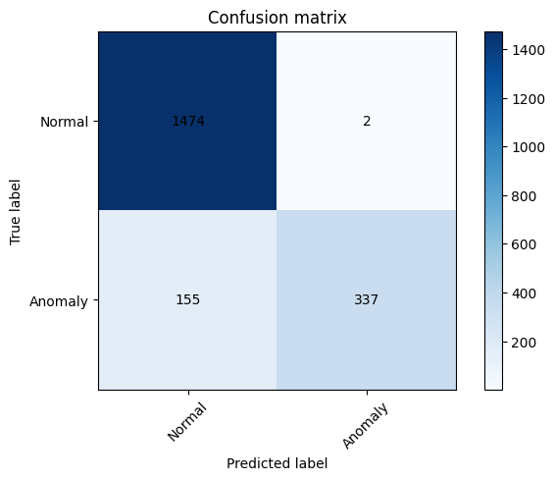
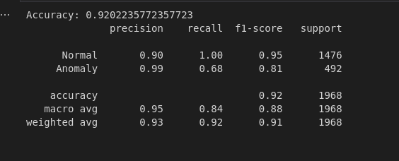
If we use the ratio 10:1 with simplif. autoencoder in the bottom

Slide 28

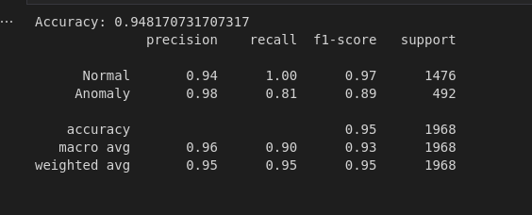
If we use the ratio 10:1 with simplif. autoencoder on top

Slide 29
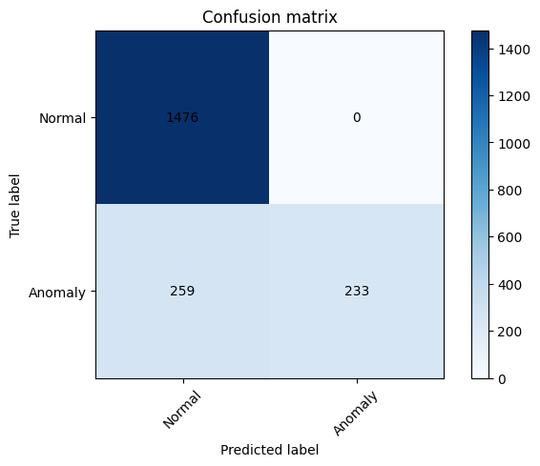
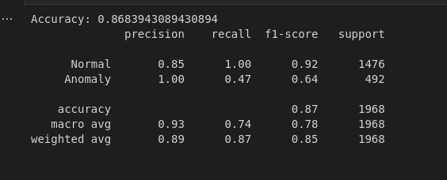
If we use the ratio 10:1 with simplif. on top without drop

Slide 30

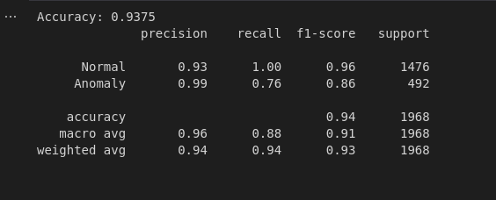
If we use ratio 15:1 with simplified autoencoder on top

Slide 31

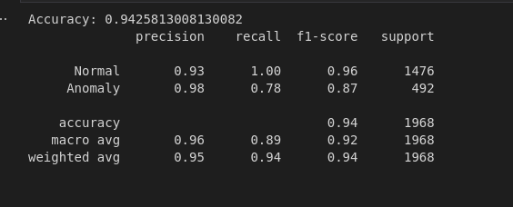
If we use ratio 15:1

Slide 32

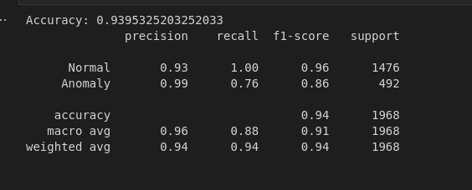
If we use ratio 20:1

Slide 33

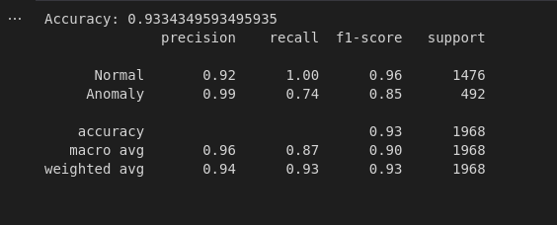
If we use ratio 30:1

Slide 34
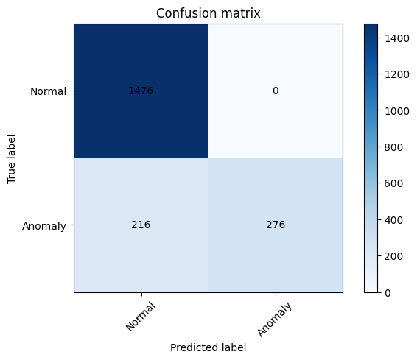

If we use ratio 30:1 with simplified autoencoder

